Slide 1
CHAPTER 2
The File
In this chapter we will look at the fundamental primitives UNIX provides for handling files from within programs.
Prof. Ju-Hong Lee, Data Science Lab, Inha Univ

Slide 2
File and Filesystem (1/2)
File
A container for data
File is a contiguous sequence of bytes.
No format imposed by the operating system
Each byte is individually addressable in a disk file
File is also a uniform interface to external devices
Filesystem
Method for storing and organizing computer files and the data.
Make it easy to find and access files.
File systems may use a data storage device
hard disk, CD-ROM

Slide 3
File and Filesystem (2/2)
User app
User app
User app
User app
user level
trap
kernel level
System Call Interface
open
create
close
read
write
lseek
unlink
remove
fcntl
File System Management
File System Interface
buffer cache
character
block
device driver
Hardware Control
H/W
level
Hardware

Slide 4
2.1 UNIX file access primitives

Slide 5
UNIX primitives
Name
open create close read write lseek unlink remove fcntl
Description
Opens a file for reading or writing, or creates Creates an empty file Closes a previously opened file Extracts information from a file Places information into a file Moves to a specified byte in a file Removes a file Alternative method to remove a file Controls attributes associated with a file
This functions are not part of ANSI C, but are part of POSIX.1 and XPG3
The functions described in this chapter are often referred to as unbuffered I/O.
Unbuffered I/O is provided by the functions open, read, write, lseek, and close. These functions all work with file descriptors.

Slide 6
File Descriptor
File Descriptor
In the kernel, all open files are referred to by file descriptors.
Non negative integer (the lowest unused integer)
When we open an exiting file or create a new file, kernel returns a file descriptor to the process.
Argument to either read or write.
Each process created by a Unix shell begins life with three open files associated with a terminal:
File descriptor | Symbolic constant | describe
0 | STDIN_FILENO | Standard input
1 | STDOUT_FILENO | Standard output
2 | STDERR_FILENO | Standard error

Slide 7
example p.8 (14)
/* a rudimentary example program */
/* these header files are discussed below */
#include <fcntl.h>
#include <unistd.h>
main()
{
int fd;
ssize_t nread;
char buf[1024];
/* open file “data” for reading */
fd = open(“data”, O_RDONLY);
/* read in the data */
nread = read(fd, buf, 1024);
/* close the file */
close(fd);
}
Primitive System Data Types
*These data types that end in _t are called the primitive system datatype
*They are usually defined in the header <sys/types.h> (which are header <unistd.h> must have included)
*Their purpose is to prevent program from using speific data types(int, float..) to allow each implementation to choose which data type is required for a particular system
File descriptor table
[0] | Std in
[1] | Std out
[2] | Std err
[3] | “data”

Slide 8
The open(2) system call (1/2)
#include <fcntl.h>
int open(const char *pathname, int flags, [mode_t mode]);
Returns: file descriptor if OK, -1 on error
A file is opened or created by calling the open function.
Arguments
flags:
O_RDONLY #0 Open for reading only.
O_WRONLY #1 Open for writing only.
O_RDWR #2 Open for reading and writing.
* one and only one of these three constants must be specified.
Why three flags? Can’t we scrap O_RDWR and just use O_RDONLY | O_WRONLY?
No, because implementation have always defined O_RDONLY as 0.
➔ O_RDONLY | O_WRONLY == O_WRONLY

Slide 9
The open(2) system call (2/2)
optional flags:
O_APPEND Append to the end of file on each write.
O_CREAT Create the file if it doesn't exist.
O_EXCL Generate an error if O_CREAT is also specified and the file already exists.
O_TRUNC If the file exists, truncate its length to 0.
O_NONBLOCK non-blocking file open.
mode:
only used with the O_CREAT flag
File security permission
fd = open(“/tmp/newfile”, O_WRONLY|O_CREAT, 0644);
/* if isExist(file) “file open” else “file create & open” */
fd = open(“/tmp/newfile”, O_WRONLY|O_CREAT|O_EXCL, 0644);
/* if isExist(file) “open error” else “file create & open” */
fd = open(“/tmp/newfile”, O_WRONLY|O_CREAT|O_TRUNC, 0644);
/* if isExist(file) “file truncate & open ” else “file create & open” */

Slide 10
example p.11 (18)
#include <stdlib.h> /* exit() */
#include <fcntl.h> /* open() */
char *workfile = “junk”;
main()
{
int fd;
if( (fd = open(workfile, O_RDWR)) == -1)
{
printf(“Couldn’t open %s\n”, workfile);
exit(1);
}
exit(0);
}
Most standard include files normally reside in the directory /usr/include
20 open files per process
But, most UNIX systems today provide far more than 20

Slide 11

File permissions

Slide 12
Symbolic names for file permissions
Name
S_IRUSR S_IWUSR S_IXUSR S_IRWXU S_IRGRP S_IWGRP S_IXGRP S_IRWXG S_IROTH S_IWOTH S_IXOTH S_IRWXO S_ISUID S_ISGID
Description
read by owner write by owner execute by owner read, write, execute by owner read by group write by group execute by group read, write, execute by group read by others write by others execute by others read, write, execute by others set user ID on execution set group ID on execution
int fd;
mode_t fdmode = ( S_IRUSR |
S_IWUSR |
S_IRGRP |
S_IROTH );
fd = open(“file”, O_RDWR | O_CREAT, fdmode);

Slide 13
The creat(2) system call
#include <fcntl.h>
int creat(const char *pathname, mode_t mode);
Returns: file descriptor if OK, -1 on error
Alternative way to create a file.
If the file already exists then the second argument is ignored
Unlike open, creat will always truncate an existing file before returning its file descriptor
creat always opens a file for writing only.
fd = creat(“/tmp/newfile”, 0644);
==
fd = open(“/tmp/newfile”, O_WRONLY|O_CREAT|O_TRUNC, 0644);

Slide 14
Owner and permission of a new file
When you create a new file (open or create)
You need write permission in the in the parent directory, since a new link will be added to it.
Directory is just a file that contains a list of files in the directory.
Who owns it?
The owner is set from the effective user-ID of the process.
The group is set to the effective group-ID of the process.

Slide 15
The close(2) system call
#include <unistd.h>
int close(int filedes);
Returns: 0 if OK, -1 on error
An open file is closed by close
Note that, to prevent total chaos, all open files are automatically closed when a program completes execution.
fd = open(“/tmp/newfile”, O_RDONLY);
.
.
.
fd = close(fd);

Slide 16
The read(2) system call (1/2)
#include <unistd.h>
ssize_t read(int filedes, void *buffer, size_t n);
Returns: number of bytes read, 0 if end of file, -1 on error
Reading a file copies bytes from the current file position to memory, and then updates file position.
Arguments
filedes
file descriptor ( obtained from open or creat)
buffer
is a pointer to an array or structure into which data will be copied
n
number of bytes to be read from the file.

Slide 17
The read(2) system call (2/2)
int fd;
ssize_t n1, n2, n3;
char buf1[512], buf2[512], buf3[512];
if( (fd = open(“foo”, O_RDONLY)) == -1)
return -1;
/* f_offset : 0 */
n1 = read(fd, buf1, 512); /* n1 : 512, f_offset : 512 */
n2 = read(fd, buf2, 512); /* n2 : 188, f_offset : 700 */
n3 = read(fd, buf3, 512); /* n3 : 0, when read EOF */
File descriptor table
File
[0]
[1]
[2]
[3]
Std in
Std out
Std err
File Table
file size
700byte
count 1
O_RDONLY
file offset
fd
3
user program area
kernel area

Slide 18
The write(2) system call
#include <unistd.h>
ssize_t write(int filedes, const void *buffer, size_t n);
Returns: number of bytes written if OK, -1 on error
Writing a file copies bytes from memory to the current file position, and then updates current file position.
Arguments
filedes : file descriptor ( obtained from open or creat)
buffer : is a pointer to the data to be written
n : number of bytes to be written
If a program opens an existing file for writing
the old data in the file will be overwritten by the new, character by character
If O_APPEND option was specified in the open, file’s offset is set to the current end of file

Slide 19
int copyfile ( const char *name1, const char *name2){
int infile, outfile;
ssize_t nread;
char buffer[BUFSIZE]; /* BUFSIZE : 512 */
if ( (infile = open (name1, O_RDONLY ) )== -1)
return(-1);
/* FMODE : O_WRONLY｜O_CREAT｜O_TRUNC */
if ( (outfile = open (name2, FMODE, PERM) )== -1){
close (infile);
return (-2);
}
while ( (nread = read (infile, buffer, BUFSIZE) ) > 0){
if ( write(outfile, buffer, nread) < nread ){
close (infile);
close (outfile);
return (-3); /* 쓰기 오류 */
}
}
close (infile);
close (outfile);
if ( nread == -1) return (-4) /* 마지막 읽기에서 오류 발생 */
else return (0); /* 만사가 잘 되었음*/
}
example p.20(29)

Slide 20
read, write and efficiency (1/3)
copyfile(“test.in”, “test.out”);
BUFSIZE | Real time | User time | System time
1 64 512 4096 8192 | 0:24.49 0:0.46 0:0.12 0:0.07 0:0.07 | 0:3.13 0:0.12 0:0.02 0:0.00 0:0.01 | 0:21.16 0:0.33 0:0.08 0:0.05 0:0.05
Increasing the buffer size improves performance.
The best performance of all is achieved when BUFSIZE is multiple of the system’s natural disk blocking factor
natural disk block : stat’s st_blksize
Reducing the number of system calls
Switching mode between program and kernel when a system call is made can be relatively expensive.

Slide 21
read, write and efficiency (2/3)
The write system call is too fast. Why?
When you issue a write system call, it does not perform the write and then return.
It just transfer the data to a buffer cache in the kernel and then returns. → delayed writing
However, if there is a disk error, or if the kernel stops for any reason, then the game is up. We discover that the data we “wrote” isn’t on the disk at all.

Slide 22
read, write and efficiency (3/3)
System kernel block
ps1
ps2
ls
shell
user level
trap
kernel level
System Call Interface
File System Management
Process Management
buffer cache
scheduler
IPC
character
block
memory management
device driver
Hardware Control
H/W
level
Hardware

Slide 23
The lseek(2) system call (1/2)
#include <unistd.h>
/* the character l in the name lseek means “long integer” */
off_t lseek(int filedes, off_t offset, int start_flag);
Returns: new file offset if OK, -1 on error
An open file's offset can be set explicitly by calling lseek
A file offset is a position in a regular file that marks where the next read or write will occur.
Arguments
filedes : file descriptor ( obtained from open or creat)
if refer to a pipe, FIFO or socket, sets errno to ESPIPE(return -1)
offset : number of bytes from start_flag
start_flag : starting position
SEEK_SET #0
SEEK_CUR #1
SEEK_END #2
SEEK_SET
a
b
c
d
SEEK_CUR
SEEK_END

Slide 24
The lseek(2) system call (2/2)
off_t nepos;
newpos = lseek(fd, (off_t)-16, SEEK_END);
----------------------------------------------------------------------------
fd = open(fname, O_RDWR);
lseek(fd, (off_t)0, SEEK_END);
write(fd, outbuf, OBSIZE);
==
fd = open(fname, O_WRONLY|O_APPEND);
write(fd, outbuf, OBSIZE);
----------------------------------------------------------------------------
off_t filesize;
int filedes;
filesize = lseek(fd, (off_t)0, SEEK_END); /* filesize is the size of file */
Notes:
02_append.c
02_append_lseek.c
02_append_end.c
/****************************** append ******************************/
$ cat > 02_append_file
xxxxx^D
$ ./append 02_append_file &
[1] 9903
Press any key!!
$ ./append_end 02_append_file
Press any key!!
End : Press any key!!
[1]+ Stopped ./append 02_append_file
$ cat 02_append_file
xxxxxeeeee
$ fg 1
./append 02_append_file
$ cat 02_append_file
xxxxxeeeeeaaaaa
/****************************** append ******************************/
/****************************** lseek ******************************/
$ cat > 02_append_file
xxxxx^D
$ ./append_lseek 02_append_file &
[1] 9903
Press any key!!
$ ./append_end 02_append_file
Press any key!!
End : Press any key!!
[1]+ Stopped ./append 02_append_file
$ cat 02_append_file
xxxxxeeeee
$ fg 1
./append_lseek 02_append_file
$ cat 02_append_file
xxxxxaaaaa
/****************************** lseek ******************************/

Slide 25
File Share (1/4)
Every process has an entry in the process table. Within each process table entry is a table of open file descriptors.
file descriptor flag
a pointer to a file table entry
The kernel maintains a file table for all open files. Each file table entry contains
The file status flags for the file(read, write … )
The current file offset
A pointer to the v-node table entry for the file
Each open file (or device) has a v-node structure that contains information about the type of file and pointers to functions that operate on the file.

Slide 26
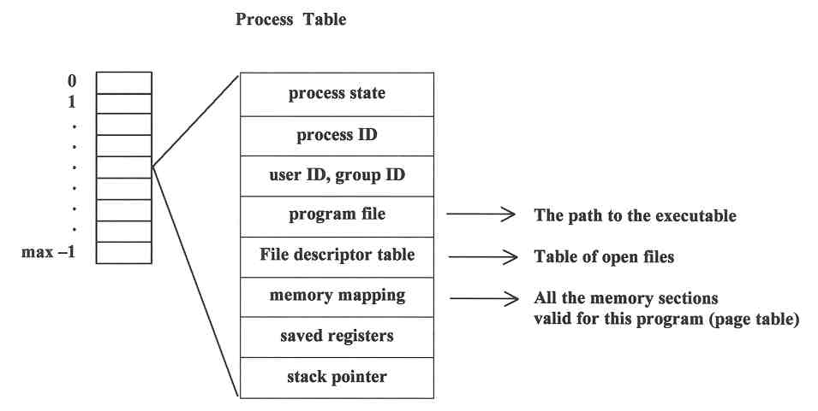
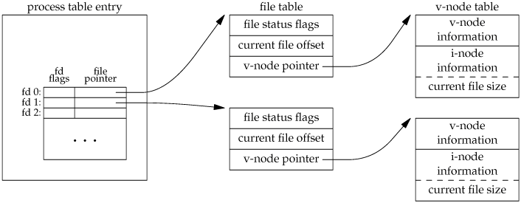
File Share (2/4)
$ ./a.out
a.out

Slide 27
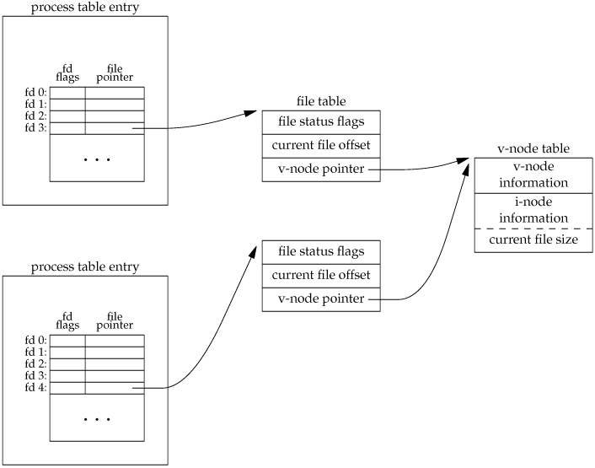
File Share (3/4)
$ ./a.out /* fd = open(“test”, O_RDONLY); */
$ ./b.out /* fd = open(“test”, O_RDONLY); */
v-node: Fundamental abstraction representing a file in the kernel
a.out
b.out
each process has its own current offset for the file
Notes:
02_des.c

Slide 28
File Share (4/4)
int fd3, fd4; char buf[20];
fd3 = open(“file”, O_RDWR);
fd4 = open(“file”, O_RDONLY);
read(fd3, buf, 20); printf(“fd3: %s\n”, buf);
read(fd4, buf, 30); printf(“fd4: %s\n”, buf);
close(fd3);
close(fd4);
process table entry
file table
status | O_RDWR
count | 1
offset | 0
v-node ptr
v-node table
v-node info
I-node info
current file size
 | fd flag | file pointer
fd 0:
fd 1:
fd 2
fd 3
fd 4:
 | …
20
file table
status | O_RDONLY
count | 1
offset | 0
v-node ptr
30

Slide 29
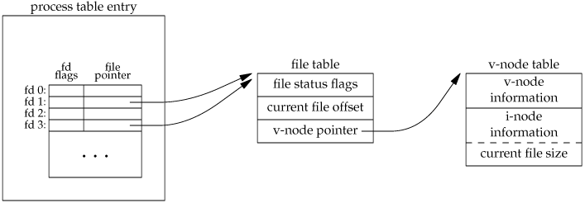
The dup(2)and dup2(2)system call
#include <unistd.h>
int dup(int filedes);
int dup2(int filedes, int filedes2);
Both return: new file descriptor if OK, -1 on error
An existing file descriptor is duplicated by either of the following functions.
newfd = dup(1) /* STDOUT_FILENO #1 */
==
newfd = fcntl(1, F_DUPFD, 0);
!=
newfd = 1

Slide 30
Example : dup2(2)
fd4 = open(“test”, O_RDONLY); /* fd4 == 4 */
dup2(3, fd4); /* test’s file descriptor closed */
==
close(fd4);
fcntl(3, F_DUPFD, fd4)
file table
status | O_RDWR
count | 1
offset | 0
v-node ptr
v-node table
v-node info
I-node info
current file size
process table entry
 | fd flag | file pointer
fd 0:
fd 1:
fd 2:
fd 3:
fd 4:
 | …
2
“test”’s file table
status | O_RDONLY
count | 1
offset | 0
v-node ptr
v-node table
v-node info
I-node info
current file size
0

Slide 31
The fcntl(2) system call(1/2)
#include <fcntl.h>
int fcntl(int filedes, int cmd, ...);
Returns: depends on cmd if OK (see following), , -1 on error
The fcntl function can change the properties of a file that is already open
Arguments
filedes : file descriptor ( obtained from open or creat)
cmd : The programmer selects a particular function by choosing a value for the integer cmd parameter
F_DUPFD : Duplicate an existing descriptor
F_GETFD or F_SETFD : Get/set file descriptor flags → ch05
F_GETFL or F_SETFL : Get/set file status flags
F_GETOWN or F_SETOWN : Get/set asynchronous I/O ownership →ch06
F_GETLK, F_SETLK, or F_SETLKW : Get/set record locks → ch08

Slide 32
The fcntl(2) system call(2/2)
#include <fcntl.h>
int filestatus(int filedes)
{
int arg1;
if (( arg1 = fcntl (filedes, F_GETFL)) == -1)
{
printf ("filestatus failed\n");
return (-1);
}
printf ("File descriptor %d: ",filedes);
/* 개방시의 플래그를 테스트한다. */
switch ( arg1 & O_ACCMODE){
case O_WRONLY: printf ("write-only"); break;
case O_RDWR: printf ("read-write"); break;
case O_RDONLY: printf ("read-only"); break;
default: printf("No such mode");
}
if (arg1 & O_APPEND)
printf (" -append flag set");
printf ("\n");
return (0);
}
access mode bits
status flags
O_APPEND
O_DSYNC
O_NONBLOCK
O_RSYNC
O_SYNC
O_ACCMODE
O_RDONLY
O_RDWR
O_WRONLY

Slide 33
2.2 Standard input, standard output and standard error

Slide 34
Redirection (1/3)
$ prog_name
$ prog_name < infile
process table entry
file table
file status flags
current file offset
v-node ptr
 | fd flag | file pointer
fd 0:
fd 1:
fd 2:
fd 3:
 | …
prog_name
standard input
/dev/fd/0’s v-node
dup2(infile, 0); /* infile ==3 */
process table entry
/dev/fd/0’s filetable
prog_name
 | fd flag | file pointer
fd 0:
fd 1:
fd 2:
fd 3:
 | …
file table
file status flags
current file offset
v-node ptr
infile
infile’s v-node
Notes:
#include <stdio.h>
#include <unistd.h>
int main()
{
char buf[BUFSIZ];
while( read(0, buf, BUFSIZ) )
{
printf("%s", buf);
}
return 0;
}

Slide 35
Redirection (2/3)
$ prog_name
$ prog_name > outfile
process table entry
file table
file status flags
current file offset
v-node ptr
 | fd flag | file pointer
fd 0:
fd 1:
fd 2:
fd 3:
 | …
prog_name
standard output
/dev/fd/1’s v-node
dup2(outfile, 1); /* outfile */
process table entry
/dev/fd/1’s filetable
prog_name
 | fd flag | file pointer
fd 0:
fd 1:
fd 2:
fd 3:
 | …
file table
file status flags
current file offset
v-node ptr
outfile
outfile’s v-node

Slide 36
Redirection (3/3)
prog_name < infile > outfile

Slide 37
io example p.30(42)
#include <stdlib.h>
#include <unistd.h>
#define SIZE 512
main()
{
size_t nread;
char buf[SIZE];
while ( (nread = read (0, buf, SIZE)) > 0)
write (1, buf, nread);
exit (0);
}
$io
This is line 1 ↓
This is line 1
This is line 2 ↓
This is line 2
<Ctrl-D>
$
Each line is printed as the Return key is pressed.
This is because read, when used to accept data from a terminal, usually return after each newline character.

Slide 38
2.3 The Standard I/O Library: a look ahead

Slide 39
The Standard I/O Library(1/3)
UNIX I/O (system call)
handles data only in the form of simple sequence of bytes
leaving everything else up to the programmer.
Efficiency consideration also fall into the lap of the developer
Standard I/O
automatic buffering
more programmer-friendly interface
This makes the library easy to use
absolve the programmer from worrying about efficiency

Slide 40
The Standard I/O Library(2/3)
Difference between Standard I/O and UNIX I/O
the way files are described.
FILE* or file descriptors
Standard I/O routines are written around the system call primitives
#include <stdio.h>
#include <stdlib.h>
main()
{
FILE *stream;
if ( ( stream = fopen ("junk", "r")) == NULL)
{
printf ("Could not open file junk\n");
exit (1);
}
}
predefined file pointer
stdin
stdout
stderr

Slide 41
The Standard I/O Library(3/3)
The C standard library (libc.a) contains a collection of higher-level standard I/O functions
Examples of standard I/O functions:
Opening and closing files (fopen and fclose)
Reading and writing bytes (fread and fwrite)
Reading and writing text lines (fgets and fputs)
Formatted reading and writing (fscanf and fprintf)

Slide 42
fopen(3)
#include <stdio.h>
FILE *fopen(const char *restrict pathname, const char *restrict type);
All three return: file pointer if OK, NULL on error
Arguments
type:
r or rb open for reading
w or wb truncate to 0 length or create for writing
a or ab append; open for writing at end of file, or create for writing
r+ or r+b or rb+ open for reading and writing
w+ or w+b or wb+ truncate to 0 length or create for reading and writing
a+ or a+b or ab+ open or create for reading and writing at end of file

Slide 43
getc(3), putc(3)
#include <stdio.h>
int getc(FILE *istream);
Return: next character if OK, EOF on end of file or error
int putc(int c, FILE *ostream);
Return: c if OK, EOF on error
int c;
FILE *istream, *ostream;
/* istream을 읽기전용으로 개방하고, ostream을 쓰기전용으로 개방하라. */
.
.
.
while( ( c=getc(istream)) !=EOF) //EOF defined in <stdio.h>, -1
putc(c, ostream);

Slide 44
Buffering
Standard I/O avoid this inefficiency by an elegant buffering mechanism.
The buffer used is usually obtained by one of the standard I/O functions calling malloc the first time I/O is performed on a stream.
Application
Standard I/O Library
user()
main()
buffering mechanism
user level
System Call Interface
kernel level

Slide 45
Writing error message with fprintf(3)
#include <stdio.h>
int fprintf(FILE *restrict fp, const char *restrict format, ...);
Return: number of characters output if OK, negative value if output error
#include <stdio.h>
#include <stdlib.h>
int notfound (const char *progname, const char *filename)
{
fprintf (stderr, "%s: file %s not found\n", progname, filename);
exit (1);
}
“restrict” prevents the same addresses from being used

Slide 46
2.4 The errno variable and system calls

Slide 47
Error Handling (1/3)
When an system call invoke,
Returns -1, if an error occurs. No error return 0
Sets error code (constants) number in errno(errno.h)
Each of these constants begin with the character E.
errno store the last type of error that occurred during a system call
errno is a globally accessible integer variable
POSIX defines errno as : extern int errno;
errno doesn’t reset when a new system call is made with no error
Therefore, Do use errno immediately after a system call has been made and has failed

Slide 48
Error Handling (2/3)
#include <string.h>
char *strerror(int errnum);
#include <stdio.h>
void perror(const char *msg);
#include <stdio.h> /* err1.c ― 에러 취급을 감안하여 화일을 개방하라. */
#include <fcntl.h>
#include <errno.h> //errno is defined
void main(int argc, char** argv)
{
int fd;
if ( (fd = open ("nonesuch", O_RDONLY)) == -1)
fprintf(stderr, "ENOENT: %s\n", strerror(errno));
errno = EACESS;
perror(argv[0]);
}
ENOENT: No such file or directory
a.out: Permission denied

Slide 49
Error Handling (3/3)
#include <stdio.h>
#include <fcntl.h>
#include <errno.h> //이것만 include하면 errno가 extern으로 지정
main()
{
int fd;
fd = open (“nonesuch”, O_RDONLY); //error, errno = ENOENT(2)
fprintf(stderr, "error %d\n", errno);
fd = open (“existfile”, O_RDONLY); //no error, errno = ENOENT(2)
fprintf(stderr, "error %d\n", errno);
}
error 2
error 2

Slide 50
Error Handling: Wrapper Functions
Since terminating on an error is the common case,
We can shorten our program by defining a wrapper function
void Close(int fd)
{
if (close(fd) == -1)
err_sys("close error");
}
pid_t Fork(void)
{ pid_t pid;
if ( (pid = fork()) == -1)
err_sys("fork error");
return(pid);
}
void err_sys(char* msg){
perror(msg);
exit(1);
}

